Slide 1
17/04/2023
ADVISOR
SHANMUKHA SAINATH
IIT Kharagpur
Professor Jayanta Mukhopadhyay
19EC10026
Project 2 (EC47007)
Predicting MGMT Promoter Methylation in Brain Tumors

Slide 2
Table of Contents
Page
I
Introduction
3
II
Related Work
5
III
Data Analysis
9
IV
Proposed Methodology
12
V
Results & Observations
26

Slide 3
Introduction
3

Slide 4
The current standard of removing Brain Tumors entails alkylating chemotherapy with temozolomide, radiation, and surgical resection.
Chemotherapy resistance to alkylating drugs is caused by an enzyme called MGMT, which can protect tumor cells from harm caused by alkylating agents.
Patients with methylated MGMT promoters have a median survival rate of 21.7 months, as opposed to 12.7 months for those with unmethylated MGMT.
MGMT promoter methylation is a favorable prognostic factor and a reliable brain tumor treatment response indicator.
In this work, we worked on predicting MGMT Promoter methylation status using mpMRI scans and segmentation mask.

Slide 5
Related Work

Slide 6
Radiomics Features
Korfiatis et al. : used a semi-automatic way to generate tumor segmentation masks from T1CE which are reviewed using ITKsnap
Zhi Cheng Le et al. : introduced the idea of a multi-centric approach where radiomics features are extracted from multiple tumor subregions. Mann-Whitney U test was used to select the most important features
Yiping Lu et al. : used radiomics features extracted from T1CE and Visually Accessible Rembrandt Images (VASARI)
Daniel Alber et al. : used DeepBraTumIA software to obtain a segmentation mask and generate features from various Tumor regions
Duyen Thi Do et al. : used a two-stage feature selection process using the XGBoost feature selection model followed by a genetic algorithm (GA)-based wrapper model.

Slide 7
Deep Learning
Xin Chen et al. : used VAE-type architecture where both segmentation and VAE tasks used the same decoder and finally used decoder and segmentation outputs for the classification task.
Yogananda et al. : introduced MGMT-net which performs voxel-wise classification of MGMT Promoter status. This generates two volumes which are then combined using the Dual Volume Fusion method on which a majority voting technique is applied to predict MGMT Promoter methylation.
Aleksandr Emchinov, Quoc-Huy Trinh et al. : used 3D EfficientNet to solve the MGMT Promoter Methylation prediction task.
Walia Farzana et al. : introduced the idea of Bayesian Optimization to tune hyperparameters of 3D CNN architecture.
Numan Saeed et al. : experimented with different 3D CNN architectures like ResNet, DenseNet , EfficientNet and Vision Transformers

Slide 8
Ensemble
Sveinn Palsson et al. : combine the use of radiomics with shape features learned by a variational autoencoder (VAE), implemented with deep neural networks. Training the VAE on tumor segmentations will help to extract complex tumor shape features that radiomics does not include.
Siman Doran et al. : used 3D EfficientNet to extract features from MRI which are then concatenated with Radiomics features. These concatenated features are used to classify the MGMT Promoter status.

Slide 9
Data Analysis

Slide 10
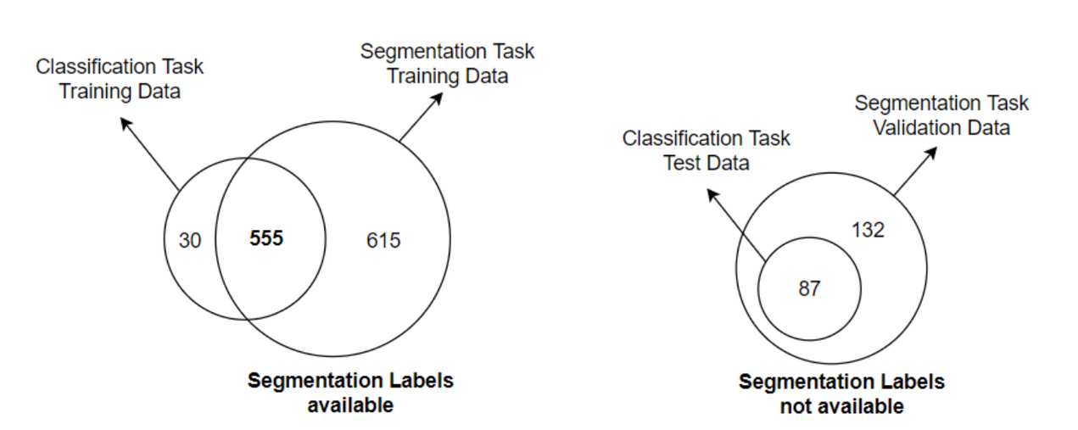
BraTS 2021
Tumor Segmentation
4 modalities of mpMRI scans with .nii.gz format along with segmentation mask for Training data
1200 Training, 219 Validation, 570 Testing
MGMT Promoter Methylation Prediction
4 modalities of mpMRI scans with .dicom format
585 Training, 87 Validation/Test

Slide 11
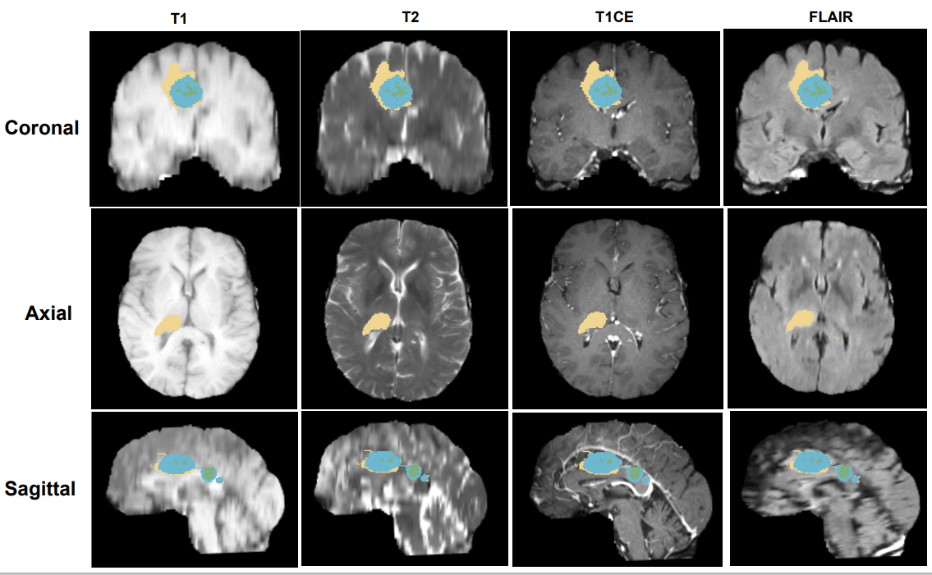
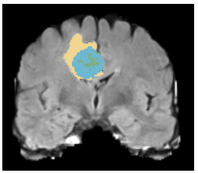

Whole Tumor
Enhancing Tumor
Tumor Core
Enhancing Tumor (ET) + Non-Enhancing Tumor (NET) + Necrotic Tumor (NET) ==> Tumor Core (TC)
Peritumoral Edema (ED) + Tumor Core (TC) ==> Whole Tumor (WT)

Slide 12
Proposed Methodology

Slide 13
Approach
Radiomics
Deep Learning
Ensemble

Slide 14
Deep Learning

Slide 15
Swin UNETR
Swin UNEt TRansformers (Swin UNETR) reformulated the task of 3D brain tumor semantic segmentation as a sequence-to-sequence prediction problem wherein multi-modal input data is projected into a 1D sequence of embedding and used as an input to a hierarchical Swin transformer as the encoder
The Swin transformer encoder extracts features at five different resolutions by utilizing shifted windows for computing self-attention and is connected to an FCNN-based decoder at each resolution via skip connections
To integrate classification task, We have added a Convolutional layer followed by Global Average Pooling and a Fully connected layer on top of the Swin Transformer encoder at different resolution's encoder output (MGMT Model).

Slide 16
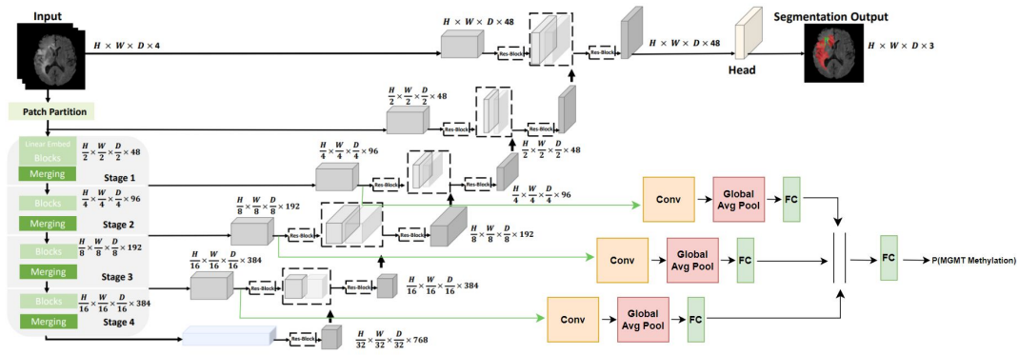

Pipeline

Slide 17
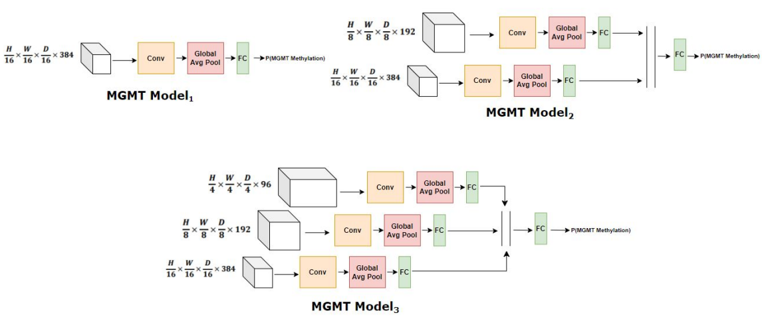
MGMT Models

Slide 18
Radiomics

Slide 19
Feature Extraction
The following features are extracted from a mpMRI scan and segmentation mask using PyRadiomics library
Shape Descriptors
First order statistics
Gray Level Cooccurrence Matrix (GLCM)
Gray Level Size Zone Matrix (GLSZM)
Gray Level Run Length Matrix (GLRLM)
Neighboring Gray Tone Difference Matrix (NGTDM)
We used trained SwinUNETR to obtain segmentation masks

Slide 20
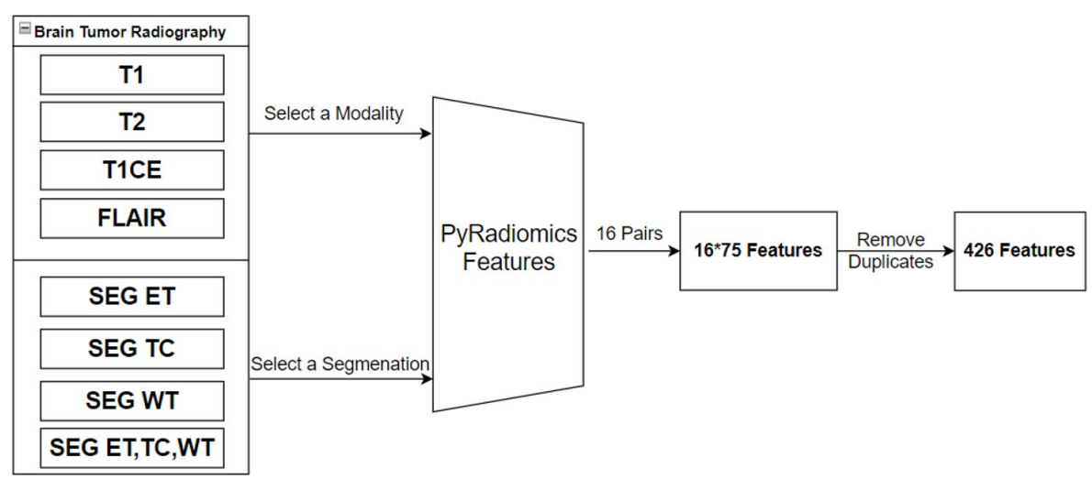
Feature Extraction

Slide 21
Feature Selection
Classifier Models
Chi-Square
PCA
Correlation Matrix
FRUFS
PyImpetus
LightGBM
XGBoost
CatBoost
Stratified k Fold cross-validation with AUROC metric

Slide 22
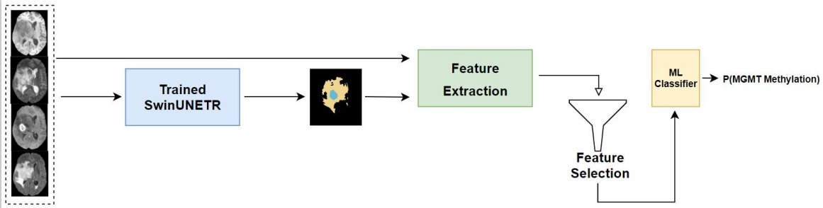
Pipeline

Slide 23
Ensemble

Slide 24
Trained SwinUNETR is used to extract segmentation masks and feature vectors.
Outputs of FC layers of MGMT Models are considered feature vectors.
The segmentation mask is then used to obtain radiomics features which undergo a feature selection process as same as the Radiomics approach.
Finally, these two sets of features are concatenated and passed to the Classifier model

Slide 25
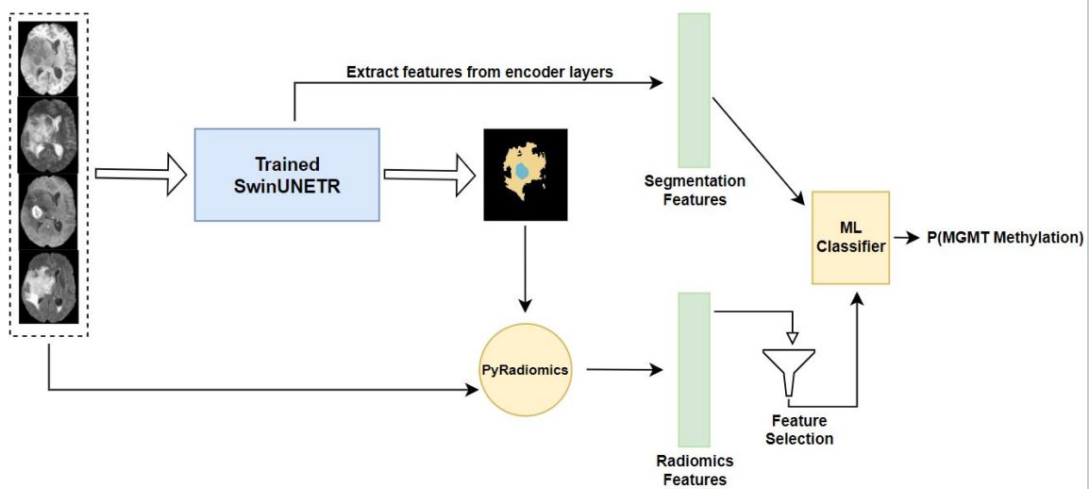
Pipeline

Slide 26
Results & Observations

Slide 27
Compared our proposed approach with all the works mentioned in BrainLes Workshop 2021
Best Method: Ensemble => SwinUNETR + MGMT Model₃ (Alpha 0.9)+ FRUFS (30) + LightGBM]
Method | Type | Public Leaderboard Score
Abler Daniel et al. | Radiomics | 0.524
Aleksandr Emchinov et al. | Deep Learning | 0.583
Walia Farzana et al. | Deep Learning | 0.477
Quoc-Huy Trinh et al. | Deep learning | 0.602
Sveinn Palsson et al. | Ensemble | 0.598
Simon Doran et al. | Ensemble | 0.603
Our best method | Radiomics | 0.609

Slide 28
Deep Learning
MGMT Model | Alpha | AUROC | Dice WT | Dice TC | Dice ET | Mean Dice
MGMT Model₁ | 0 | - | 0.932 | 0.935 | 0.899 | 0.922
MGMT Model₁ | 0.1 | 0.627 | 0.922 | 0.929 | 0.89 | 0.913
MGMT Model₁ | 0.5 | 0.689 | 0.889 | 0.919 | 0.885 | 0.897
MGMT Model₁ | 0.9 | 0.718 | 0.741 | 0.854 | 0.782 | 0.792
MGMT Model₂ | 0 | - | 0.941 | 0.939 | 0.901 | 0.927
MGMT Model₂ | 0.1 | 0.634 | 0.928 | 0.935 | 0.896 | 0.919
MGMT Model₂ | 0.5 | 0.698 | 0.896 | 0.922 | 0.876 | 0.898
MGMT Model₂ | 0.9 | 0.735 | 0.791 | 0.875 | 0.795 | 0.82
MGMT Model₃ | 0 | - | 0.939 | 0.935 | 0.897 | 0.923
MGMT Model₃ | 0.1 | 0.657 | 0.918 | 0.925 | 0.897 | 0.913
MGMT Model₃ | 0.5 | 0.703 | 0.897 | 0.915 | 0.88 | 0.897
MGMT Model₃ | 0.9 | 0.746 | 0.776 | 0.867 | 0.798 | 0.814

Slide 29
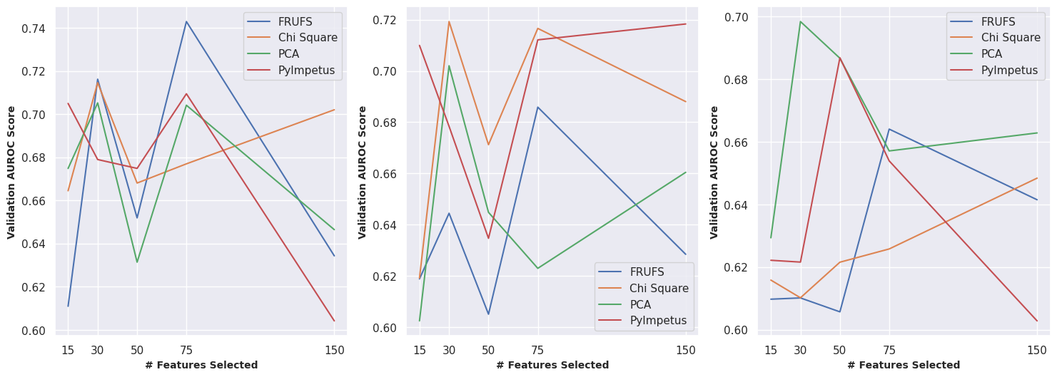
Radiomics
Light GBM
XGBoost
CatBoost

Slide 30
Ensemble
MGMT Model | Alpha | Feature Selection | No of Features | Classifier | AUROC
MGMT Model₁ | 0.9 | FRUFS | 30 | LightGBM | 0.751
MGMT Model₂ | 0.9 | FRUFS | 15 | LightGBM | 0.742
MGMT Model₁ | 0.9 | Chi Square | 30 | LightGBM | 0.739
MGMT Model₃ | 0.8 | Chi Square | 30 | CatBoost | 0.731
MGMT Model₂ | 0.9 | Corr Matrix | 30 | CatBoost | 0.729
MGMT Model₃ | 0.5 | PCA | 50 | XGBoost | 0.719
MGMT Model₁ | 0.5 | FRUFS | 30 | XGBoost | 0.711
MGMT Model₂ | 0.9 | PyImpetus | 75 | LightGBM | 0.708

Slide 31
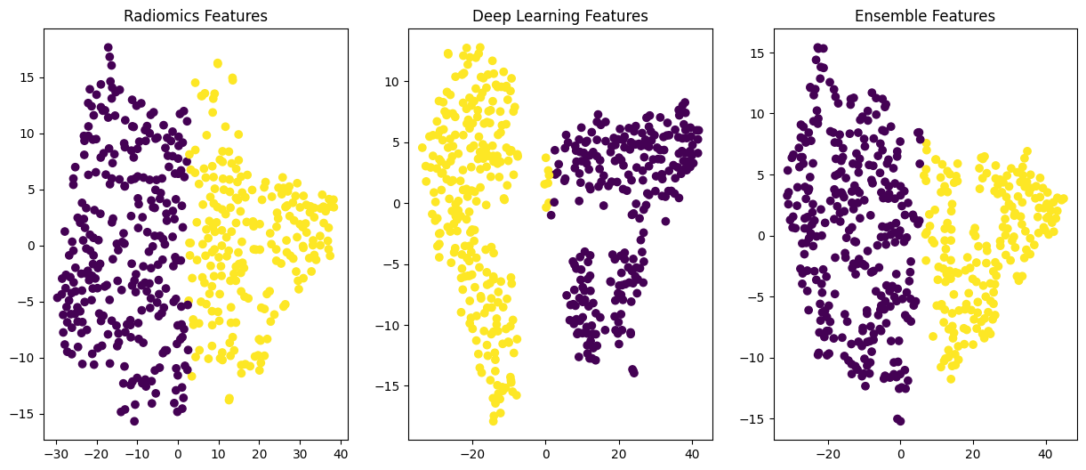
Qualitative Analysis
tSNE of features from best performing experiments for each approach based on Val AUROC

Slide 32
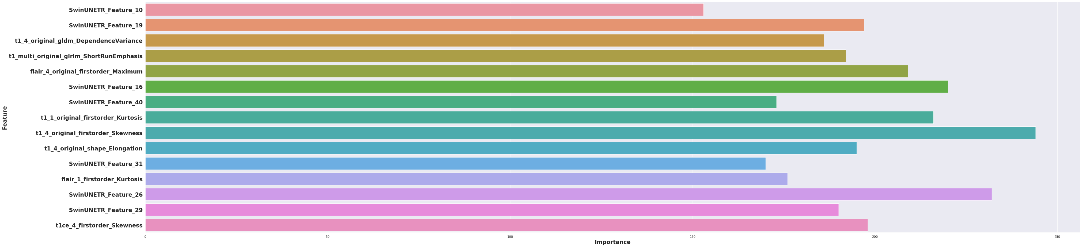
Feature Importance
Feature Importance of 30 features selected by FRUFS Method for best performing experiment
7 out of 15 features are extracted from MGMT Model₃
All the top radiomics features belong to
first order statistics from all four modalities (mainly skewness)

Slide 33
Thank You

